Slide 1
OpenPACS
Reynaud Cade, Florea Gheorghe-Casian,
Alexandru-Mircea Adam, Islamovic Armin

Slide 2
Goals
We wanted to implement a more complex viewer
We wanted to implement more data types in our database

Slide 3
Live demonstration

Slide 4
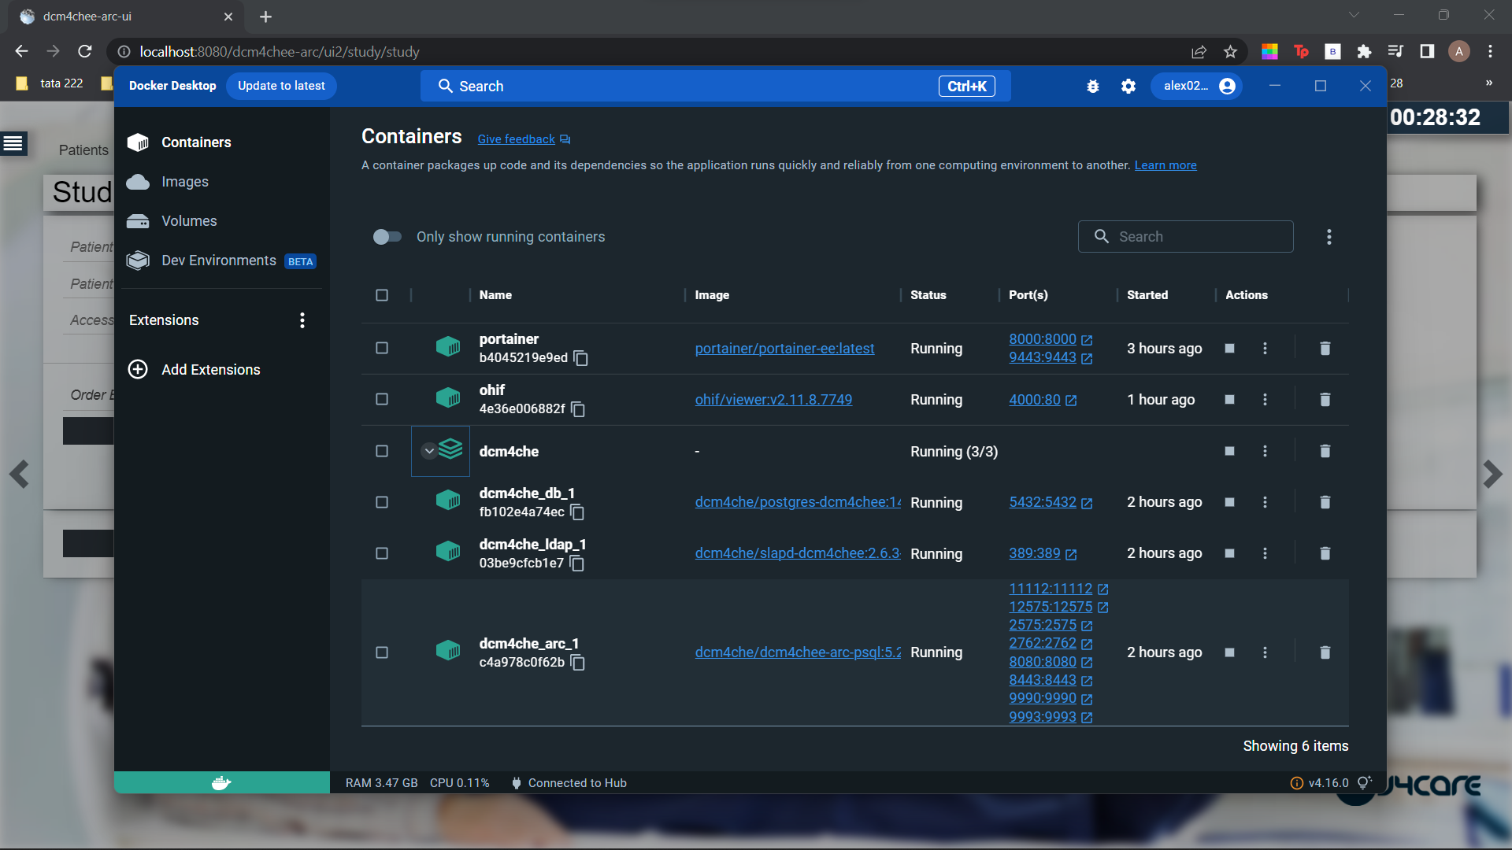
The containers installed via docker in order to be able to access DICOM

Slide 5
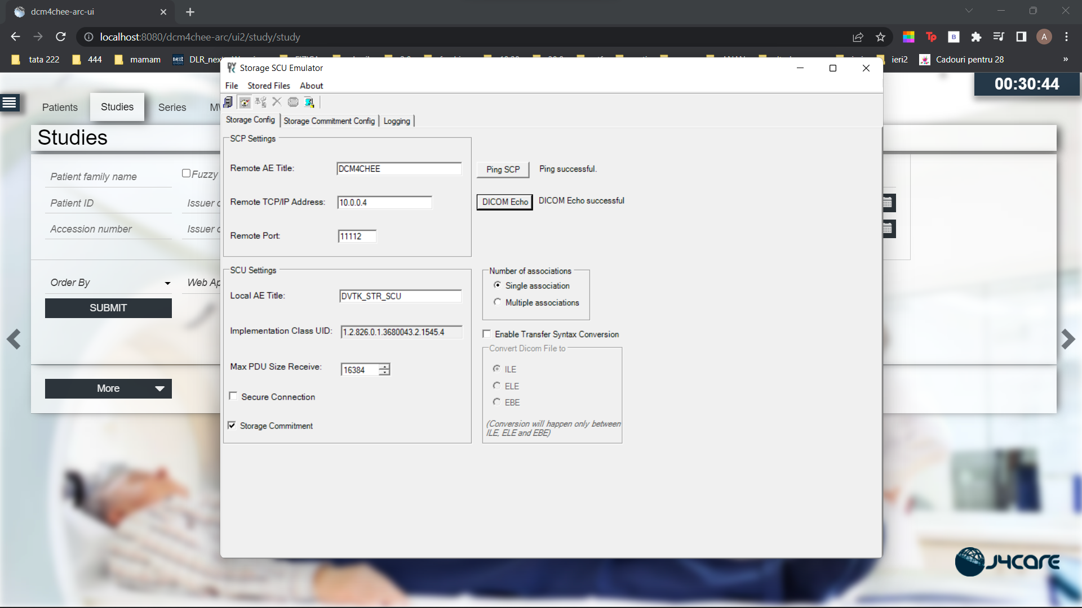
The SCU Emulator used for importing

Slide 6
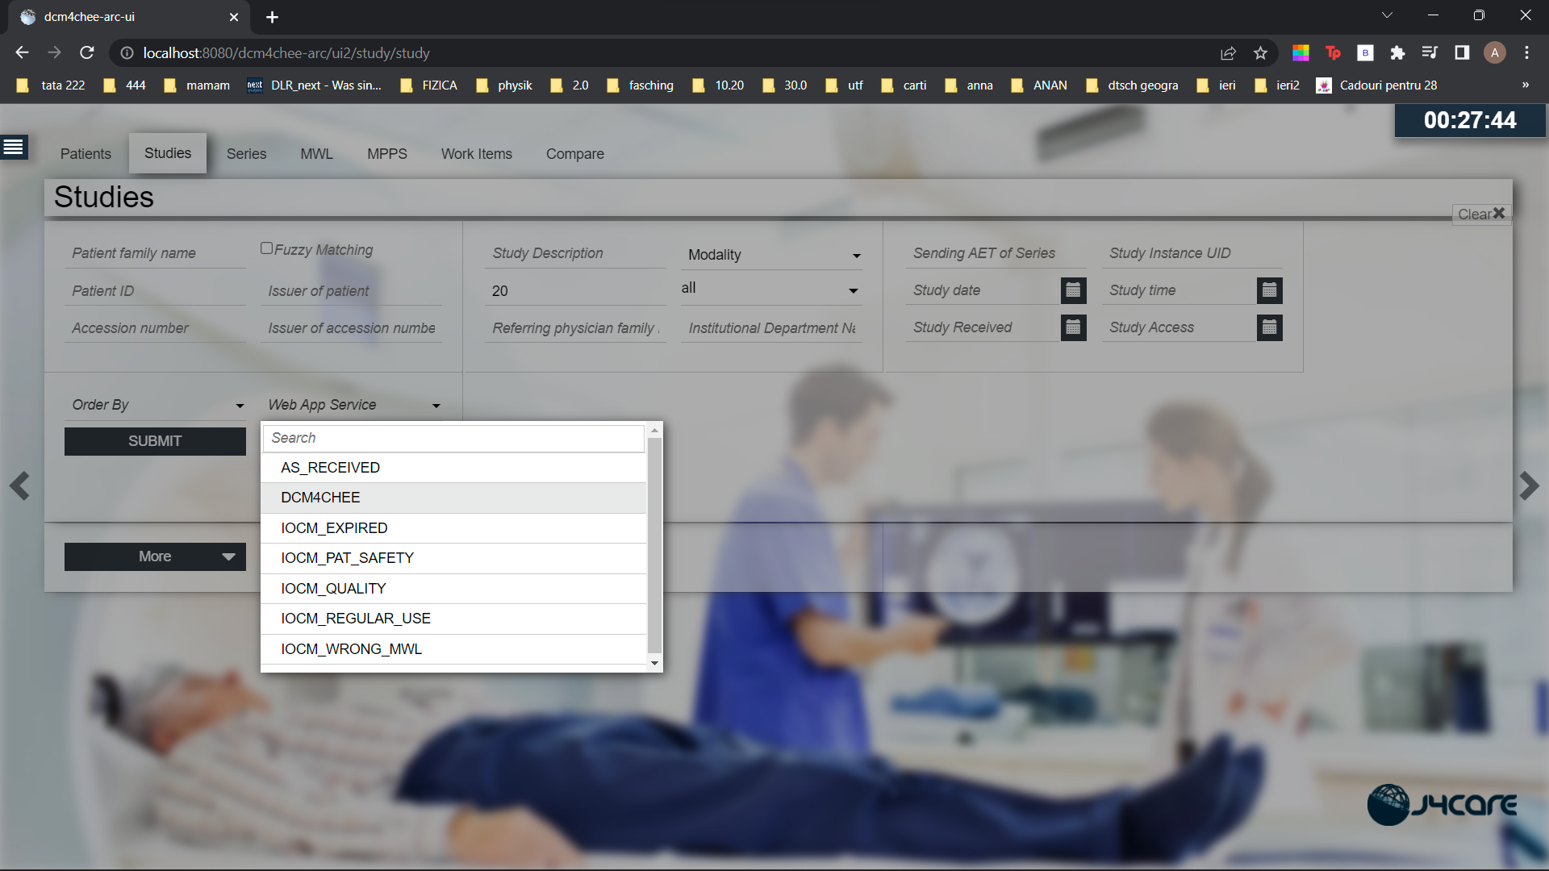
Choosing the DICOM file viewer

Slide 7
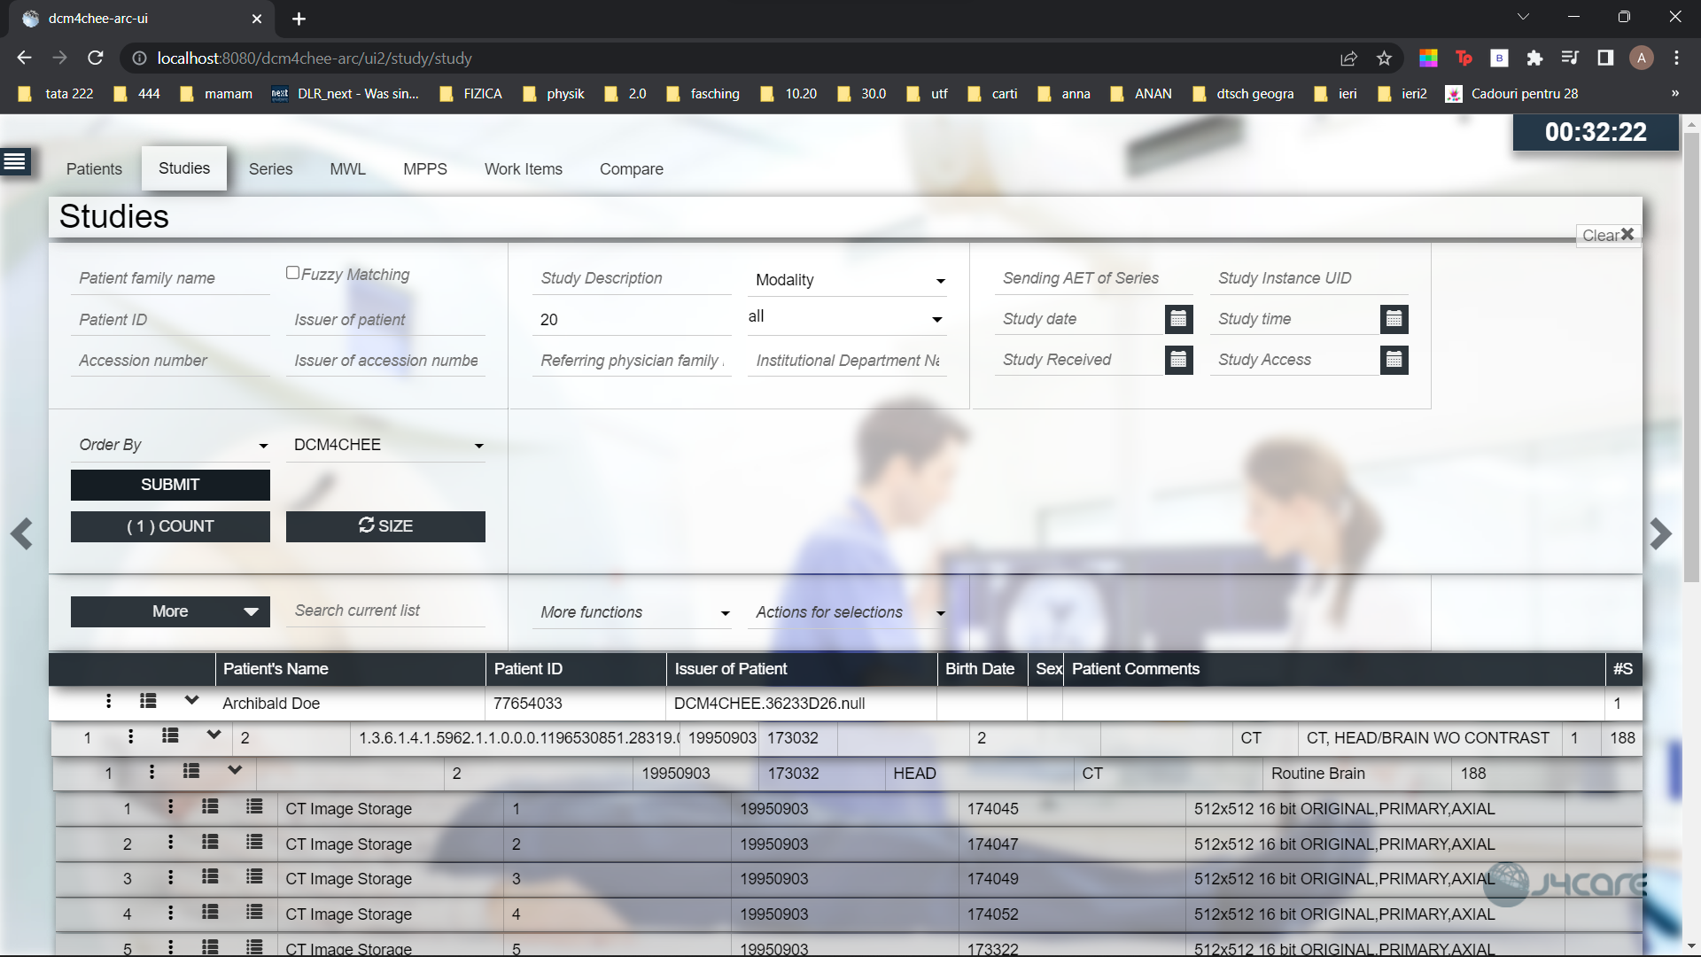
The imported data

Slide 8
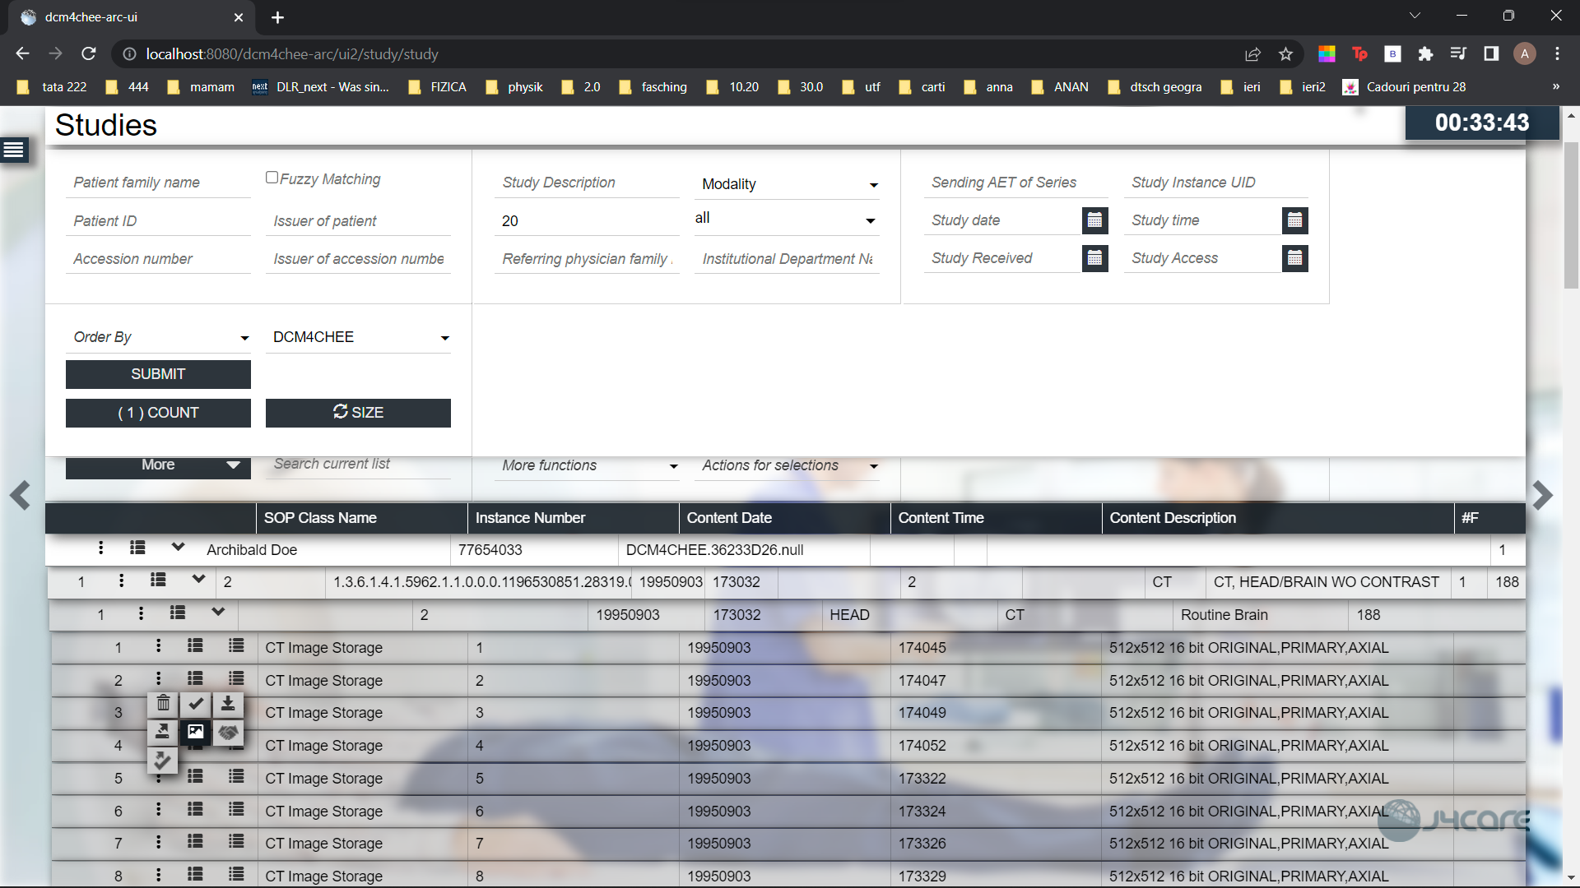
A visual representation of the actual database for the patients with their designated files

Slide 9
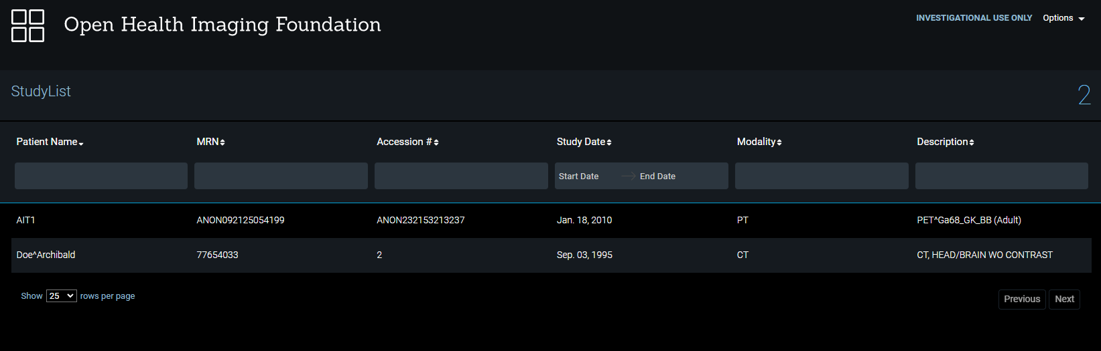
This is how the patients appear in the viewer

Slide 10
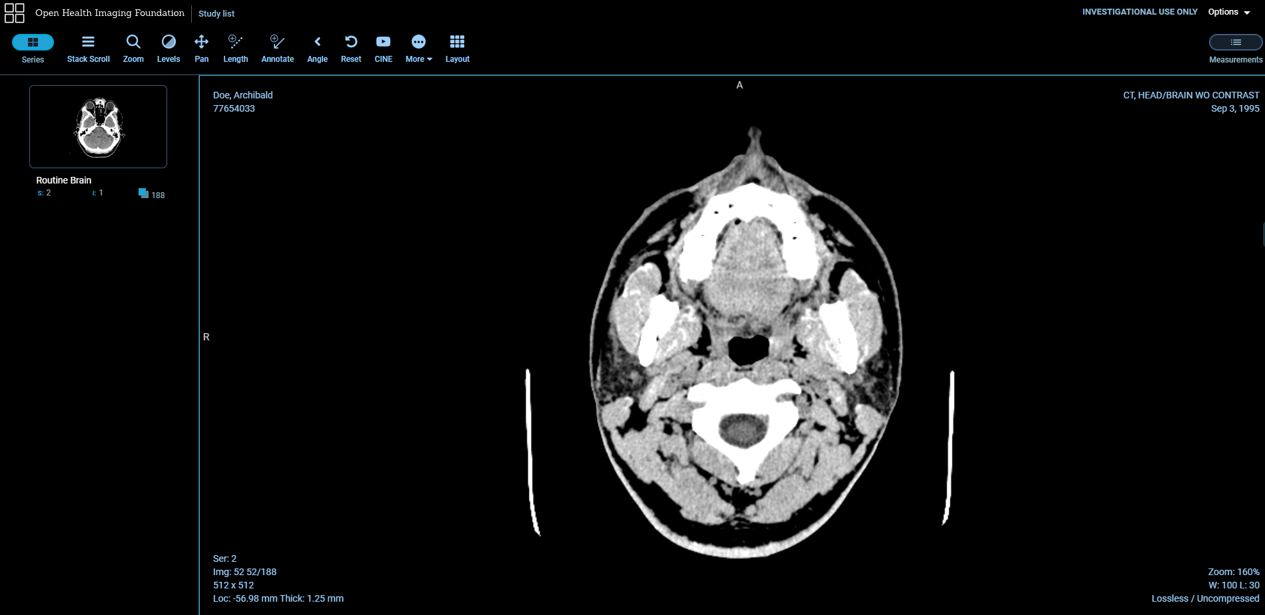
This is what a ct scan looks like in the viewer

